Slide 1


Control theory
Authors:
Yoav Rozov, Tomy Tochilovsky

Slide 2
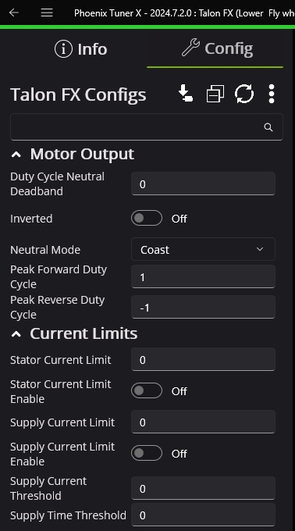
Motor Configuration
When we start working with a motor our first step would always be to configure it. Setting its ID and name is just the first part of the process. We also need to configure its NeutralMode (Coast/Brake), if the motor is inverted, its limits and more.
We can do the configuration using the Phoenix Tuner:
Notes:
Source: https://www.youtube.com/watch?v=UOuRx9Ujsog

Slide 3
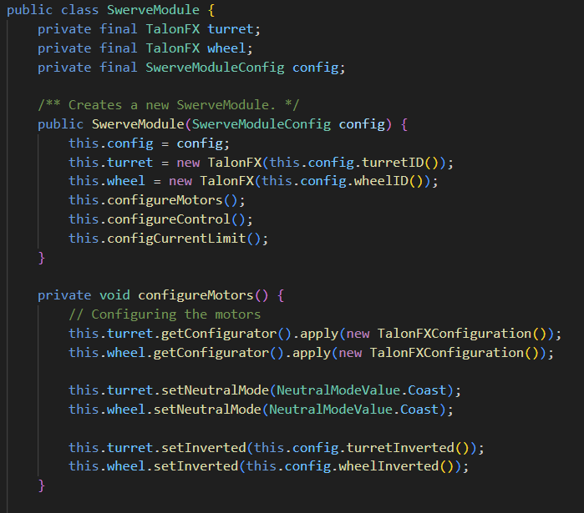
Motor Configuration
Motors can also be configured through code, and they should be configured through code when we create a subsystem. The configuration constants will be saved in the Constants.java file and applied when creating an instance of the motor in the subsystem. In the following example we see part of the motor configuration of the swerve module:
Notes:
Source: https://www.youtube.com/watch?v=UOuRx9Ujsog

Slide 4

PID
Source: https://www.youtube.com/watch?v=UOuRx9Ujsog

Slide 5
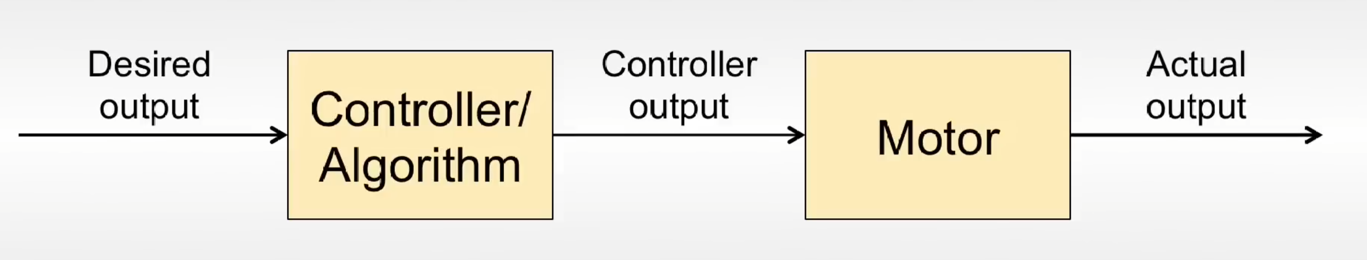
Open loop control
What is the problem with open loop control?
Doesn’t account for unexpected disturbances in the system
Notes:
Source: https://www.youtube.com/watch?v=UOuRx9Ujsog

Slide 6
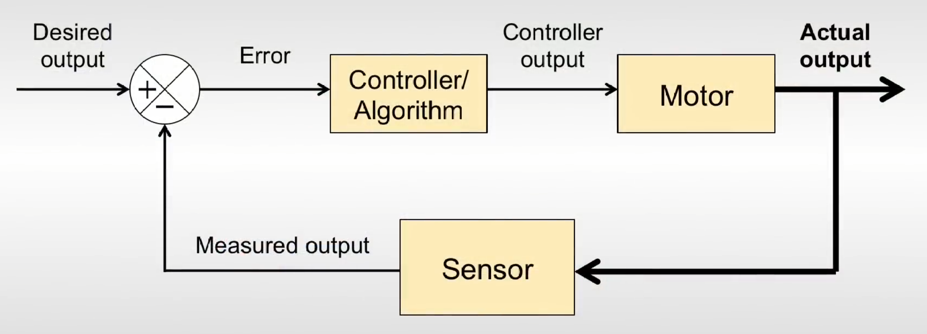
Closed loop controller
Feedback controller:
A feedback controller is a system designed to maintain a desired state (setpoint) of a variable by continuously monitoring its actual state (process variable), calculating the difference (error), and adjusting an influencing factor (output) based on that error.
PID is a very popular feedback controller
Notes:
Source: https://www.youtube.com/watch?v=UOuRx9Ujsog

Slide 7
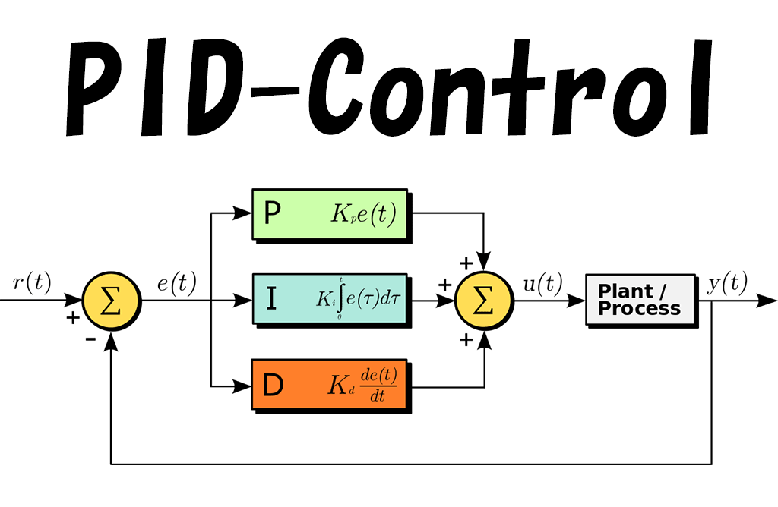
How does it work?
PID = Proportional Integral Derivative
Output voltage =
Kp * error +
Ki * accumulated-error-second +
Kd * error/second
Notes:
Source: https://www.youtube.com/watch?v=UOuRx9Ujsog

Slide 8
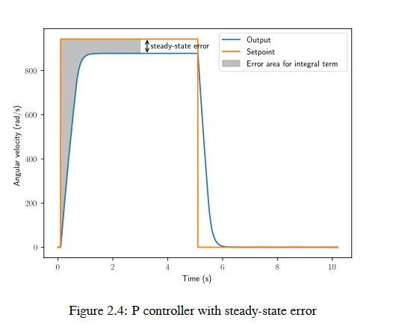
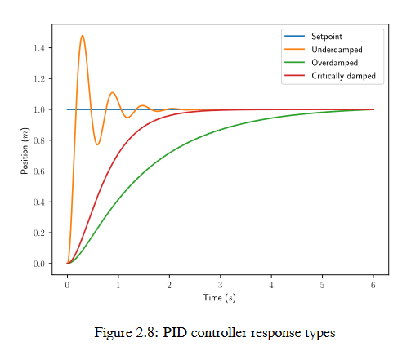
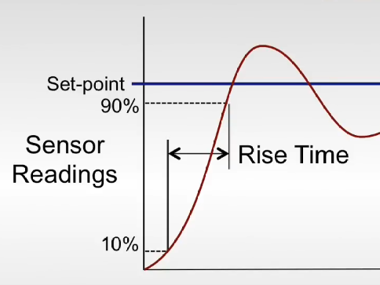
Terminology

Slide 9
Ziegler Nichols Method
Set Ki and Kd to 0
Increase Kp until output is a sustained and stable oscillation
Record the critical gain Kc (The Kp that caused the oscillation) and the oscillation period Pc
Set PID parameters as such:
Kp = 0.6 * Kc
Ki = 2 * Kp/Pc
Kd = 0.125 * Kp * Pc

Slide 10
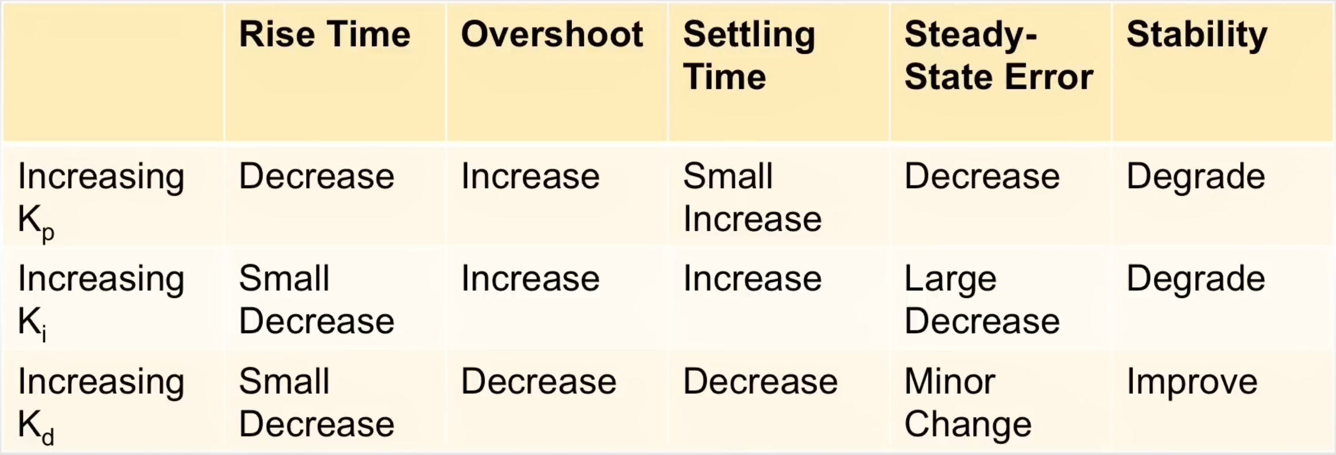
Rules of thumb
Try it here.
Notes:
https://colab.research.google.com/drive/1AqbGC0pA3tTUPmN8RgkXaOx1DoCk5dMC?usp=sharing

Slide 11
Feedforward
Source: BREAD 5940

Slide 12
Feedforward controller
Why use feedforward?
Feedforward helps the system to make a relatively accurate prediction of what the output should be
The best solution is to combine a feedforward controller and a feedback controller by adding their outputs together

Slide 13
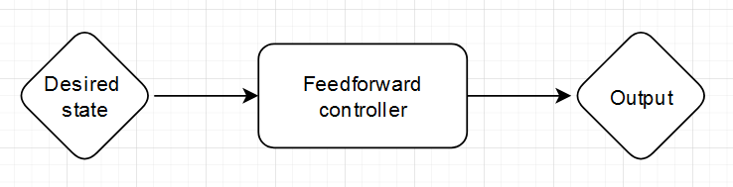
How does it work?
Output voltage =
Kg +
Ks * sign(v) +
Kv * TargetVelocity +
Ka * TargetAcceleration

Slide 14
PID + Feedforward
kG: Add fixed voltage to offset gravity in one direction
kS: Add fixed voltage to offset static friction in the direction of rotation
kV: Add voltage proportional to the desired profile velocity
kA: Add voltage proportional to the desired profile acceleration
kP: Add voltage proportional to the closed-loop error
kI: Add voltage proportional to the accumulated closed-loop error
kD: Add voltage proportional to the rate-of-change of the closed-loop error
Feedforward
Feedback

Slide 15
Motion profiles
Source: Phoenix 6 docs

Slide 16
Motion profiles
What if we want to control position? When controlling a DC motor, there’s no immediate relation between position and control signal.
To use feedforward effectively for position control, we need to produce a sequence of velocities that will take the robot mechanism to the desired position. This is called a motion profile.

Slide 17
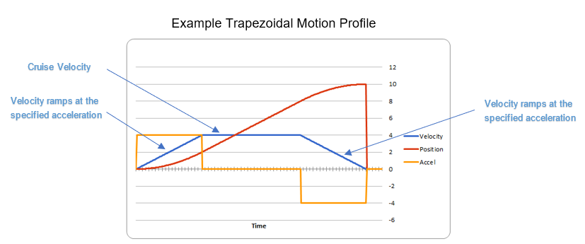
Motion Magic
Motion Magic® is a control mode that provides the benefit of Motion Profiling without needing to generate motion profile trajectory points.
*Jerk = 0

Slide 18
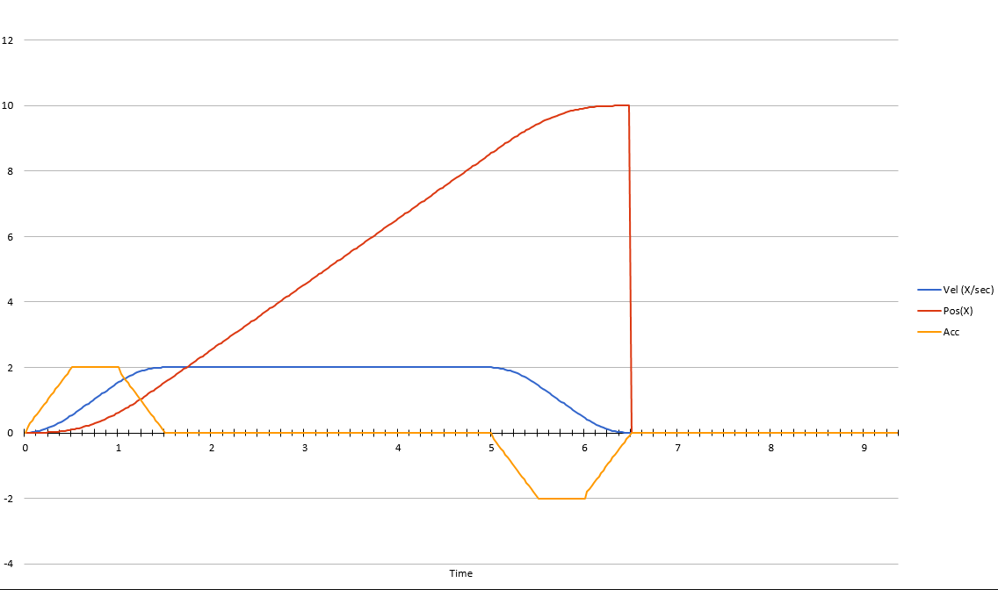
Motion Magic parameters
Cruise Velocity - peak/cruising velocity of the motion
Acceleration - controls acceleration and deceleration rates during the beginning and end of motion
Jerk (optional) - controls jerk, which is the derivative of acceleration
*Jerk != 0

Slide 19
תודה על ההקשבה

